Slide 1


Relational Database For Rocky Top Climbing Gym
Presenter name
Title
University of Colorado Boulder
DATA SCIENCE
Notes:
Business Overview: The business chosen for this project is a local climbing gym called "Rocky Top Climbing Gym." Rocky Top is a community-focused indoor climbing facility offering various climbing walls, bouldering areas, and training classes. The gym caters to climbers of all skill levels, from beginners to advanced. It also hosts climbing competitions, workshops, and social events.
Business Needs: Rocky Top needs a relational database to manage member information, track class registrations, monitor equipment rentals, and organize events. The database will help streamline operations, provide insights into membership trends, and enhance member engagement by personalizing class recommendations and managing event registrations efficiently.

Slide 2
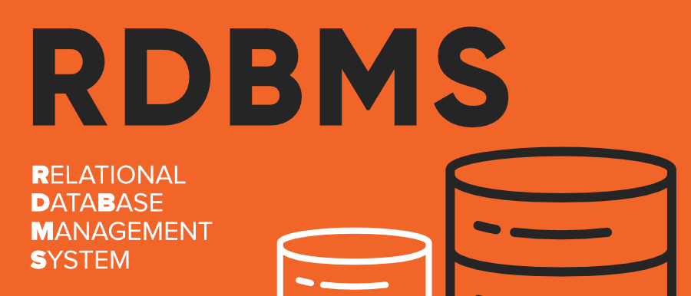
How Will RDBMS Help Rocky Top?
Improved Data Management and Accuracy
Increased Efficiency and Productivity
Enhanced Data Security
Scalability and Flexibility
Improved Reporting and Analysis
Better Customer Relationship Management
Enhanced Collaboration and Accessibility
Cost Savings and Environmental Benefits
DATA SCIENCE
Notes:
Benefits of Moving from a Paper-Based System to a Relational Database Management System (RDBMS)
Improved Data Management and Accuracy:
Elimination of Redundancy: An RDBMS helps reduce data redundancy by ensuring data is stored in a structured and centralized manner.
Enhanced Data Integrity: The use of primary and foreign keys ensures data consistency and accuracy across all related tables.
Increased Efficiency and Productivity:
Automated Data Entry and Updates: Data can be entered, updated, and retrieved quickly, reducing manual entry errors and saving time.
Streamlined Operations: Automated processes and queries allow for faster decision-making and streamlined daily operations.
Enhanced Data Security:
Controlled Access: An RDBMS provides robust security features, including user authentication and authorization, ensuring that only authorized personnel can access sensitive data.
Data Encryption: Sensitive information can be encrypted to protect it from unauthorized access and breaches.
Scalability and Flexibility:
Scalable Solutions: As the business grows, an RDBMS can easily scale to handle increased data volumes and user load without compromising performance.
Flexible Data Models: The relational model allows for flexible data structures that can adapt to changing business requirements.
Improved Reporting and Analysis:
Comprehensive Reporting: Advanced querying capabilities enable the generation of detailed reports and insights, facilitating better business decisions.
Data Analysis Tools: Integration with data analysis tools allows for deeper insights into business trends and performance metrics.
Better Customer Relationship Management:
Personalized Services: Centralized customer data enables personalized interactions and services, improving customer satisfaction and loyalty.
Efficient Communication: Quick access to customer information allows for more efficient and effective communication with clients.
Enhanced Collaboration and Accessibility:
Multi-User Access: Multiple users can access and work on the database simultaneously, promoting collaboration and teamwork.
Remote Access: With proper security measures, data can be accessed remotely, enabling flexible work environments and mobile workforce support.
Cost Savings and Environmental Benefits:
Reduced Paper Usage: Moving to a digital system reduces the need for paper, contributing to cost savings and environmental sustainability.
Lower Storage Costs: Digital data storage eliminates the need for physical storage space and reduces associated costs.

Slide 3
Our ER Model
Entities:
Member (MemberID, Name, ContactInfo, MembershipType, ExpirationDate)
Class (ClassID, Name, Date, Time, Instructor)
ClassRegistration (RegistrationID, MemberID, ClassID)
EquipmentRental (RentalID, MemberID, EquipmentType, RentalDate, ReturnDate)
Event (EventID, EventName, Date, Time, Description)
Relationships:
Member - registers for - Class (Many-to-Many through ClassRegistration)
Member - rents - Equipment (One-to-Many through EquipmentRental)
Member - attends - Event (Many-to-Many through EventRegistration)
DATA SCIENCE
Notes:
Benefits of Moving from a Paper-Based System to a Relational Database Management System (RDBMS)
Improved Data Management and Accuracy:
Elimination of Redundancy: An RDBMS helps reduce data redundancy by ensuring data is stored in a structured and centralized manner.
Enhanced Data Integrity: The use of primary and foreign keys ensures data consistency and accuracy across all related tables.
Increased Efficiency and Productivity:
Automated Data Entry and Updates: Data can be entered, updated, and retrieved quickly, reducing manual entry errors and saving time.
Streamlined Operations: Automated processes and queries allow for faster decision-making and streamlined daily operations.
Enhanced Data Security:
Controlled Access: An RDBMS provides robust security features, including user authentication and authorization, ensuring that only authorized personnel can access sensitive data.
Data Encryption: Sensitive information can be encrypted to protect it from unauthorized access and breaches.
Scalability and Flexibility:
Scalable Solutions: As the business grows, an RDBMS can easily scale to handle increased data volumes and user load without compromising performance.
Flexible Data Models: The relational model allows for flexible data structures that can adapt to changing business requirements.
Improved Reporting and Analysis:
Comprehensive Reporting: Advanced querying capabilities enable the generation of detailed reports and insights, facilitating better business decisions.
Data Analysis Tools: Integration with data analysis tools allows for deeper insights into business trends and performance metrics.
Better Customer Relationship Management:
Personalized Services: Centralized customer data enables personalized interactions and services, improving customer satisfaction and loyalty.
Efficient Communication: Quick access to customer information allows for more efficient and effective communication with clients.
Enhanced Collaboration and Accessibility:
Multi-User Access: Multiple users can access and work on the database simultaneously, promoting collaboration and teamwork.
Remote Access: With proper security measures, data can be accessed remotely, enabling flexible work environments and mobile workforce support.
Cost Savings and Environmental Benefits:
Reduced Paper Usage: Moving to a digital system reduces the need for paper, contributing to cost savings and environmental sustainability.
Lower Storage Costs: Digital data storage eliminates the need for physical storage space and reduces associated costs.

Slide 4
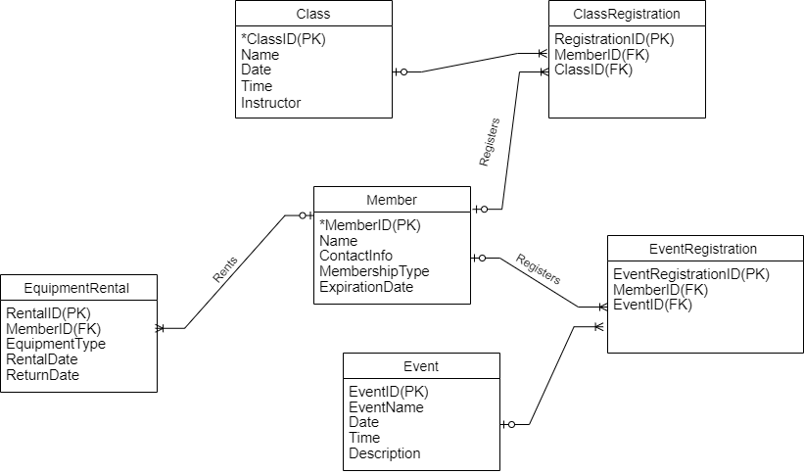
The ERD
DATA SCIENCE
Notes:
Benefits of Moving from a Paper-Based System to a Relational Database Management System (RDBMS)
Improved Data Management and Accuracy:
Elimination of Redundancy: An RDBMS helps reduce data redundancy by ensuring data is stored in a structured and centralized manner.
Enhanced Data Integrity: The use of primary and foreign keys ensures data consistency and accuracy across all related tables.
Increased Efficiency and Productivity:
Automated Data Entry and Updates: Data can be entered, updated, and retrieved quickly, reducing manual entry errors and saving time.
Streamlined Operations: Automated processes and queries allow for faster decision-making and streamlined daily operations.
Enhanced Data Security:
Controlled Access: An RDBMS provides robust security features, including user authentication and authorization, ensuring that only authorized personnel can access sensitive data.
Data Encryption: Sensitive information can be encrypted to protect it from unauthorized access and breaches.
Scalability and Flexibility:
Scalable Solutions: As the business grows, an RDBMS can easily scale to handle increased data volumes and user load without compromising performance.
Flexible Data Models: The relational model allows for flexible data structures that can adapt to changing business requirements.
Improved Reporting and Analysis:
Comprehensive Reporting: Advanced querying capabilities enable the generation of detailed reports and insights, facilitating better business decisions.
Data Analysis Tools: Integration with data analysis tools allows for deeper insights into business trends and performance metrics.
Better Customer Relationship Management:
Personalized Services: Centralized customer data enables personalized interactions and services, improving customer satisfaction and loyalty.
Efficient Communication: Quick access to customer information allows for more efficient and effective communication with clients.
Enhanced Collaboration and Accessibility:
Multi-User Access: Multiple users can access and work on the database simultaneously, promoting collaboration and teamwork.
Remote Access: With proper security measures, data can be accessed remotely, enabling flexible work environments and mobile workforce support.
Cost Savings and Environmental Benefits:
Reduced Paper Usage: Moving to a digital system reduces the need for paper, contributing to cost savings and environmental sustainability.
Lower Storage Costs: Digital data storage eliminates the need for physical storage space and reduces associated costs.

Slide 5

Welcome to the Future
Invest in a relational database management system to transform your business operations and secure a competitive edge.
DATA SCIENCE
Notes:
Invest in a Relational Database Management System to Transform Your Business Operations and Secure a Competitive Edge.
By making this investment, you are not only upgrading your data management capabilities but also positioning your business for greater success and resilience in the years to come.

